Slide 1



Database Project: office sales
Integrants:
Gaytán Medina Gabriela
Hernández Francisco Omar
Rivera Arellanes Josué David
Zarco Manzanares Daniel Alberto

Slide 2
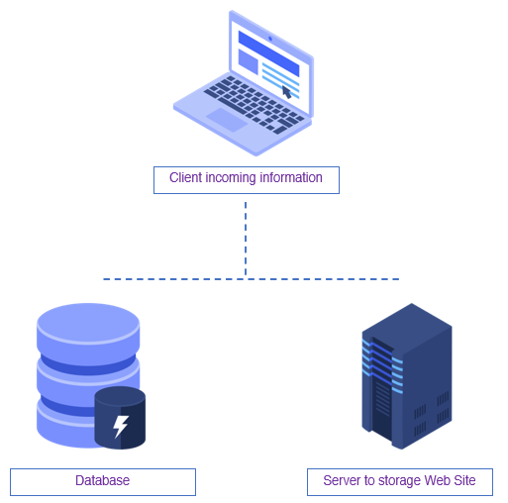
Structure’s diagram of database
Next diagram show database’s structure wich we team implemented alongside Project.
In a single computer we have a client-server’s derivation form cause through computer databse and web have interaction between them.

Slide 3
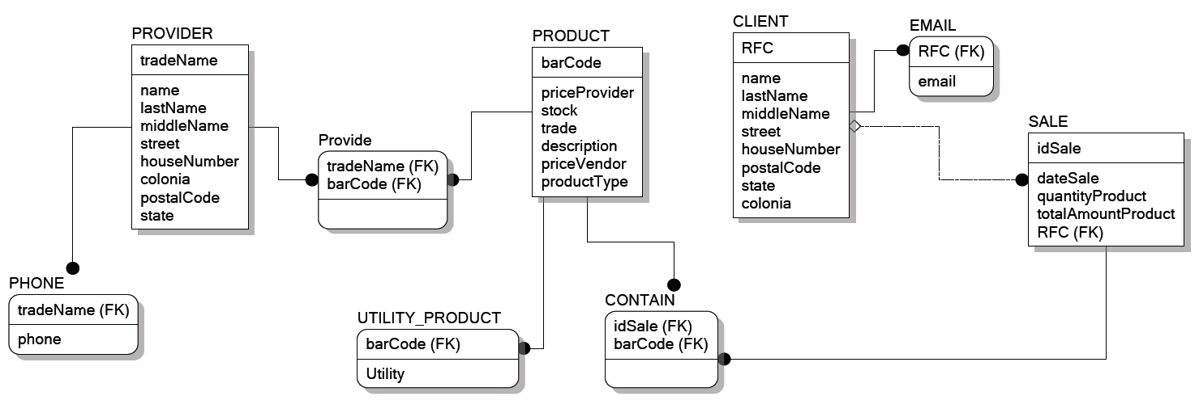
Relation model of database
Next diagram shows database’s relation model on single computer structure which we have implemented

Slide 4
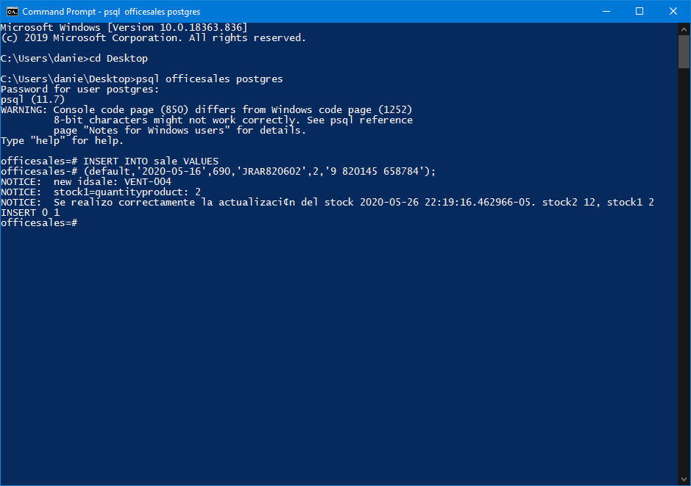
Update stock while sale’s insertion is running
While sale’s insertion is running, inside of execute trigger at moment to check product’s stock and depending of their value, execute some of three options:
Stock is les tan three
Stock is greater tan three
Stock is equal to zero

Slide 5
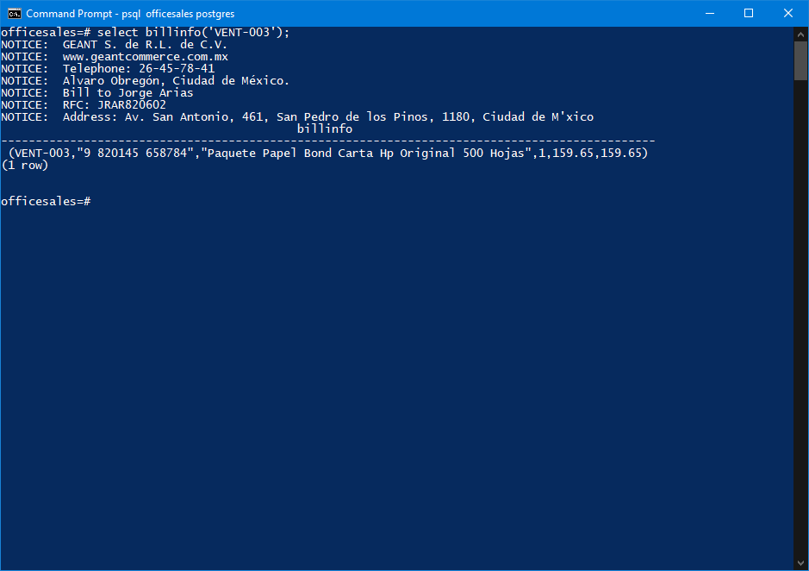
Generating Bill’s information by every sale
Database have a function which generates a bill’s sample by any sale reciving idsale as parameter.
Bill’s information contain name, rfc, date, direction and sale’s record.

Slide 6
Sell by Date
For this requiriment was necessary créate a function who can permit assign the date of purchase
We have 4 variables and 2 function parameters , inside the body of the function we realice an if for the process of the purchase.
Return query for obtain thewanted values.

Slide 7
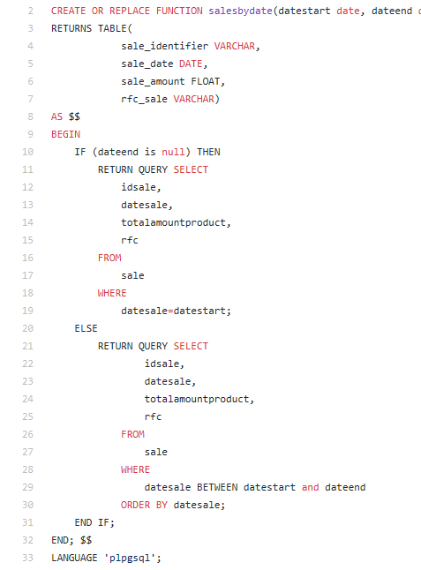
Seeing with detail the previously commented

Slide 8
Product les by three
Requiriment: recieve all products who stock is les by three.

Slide 9
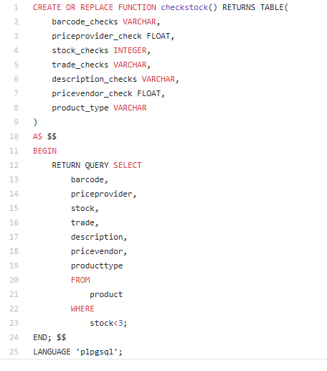
Code of the previous requiriment

Slide 10
CONECTION AND WEB DESIGN

Slide 11




Web server
Code editor
Database management system
Programming Language

Slide 12
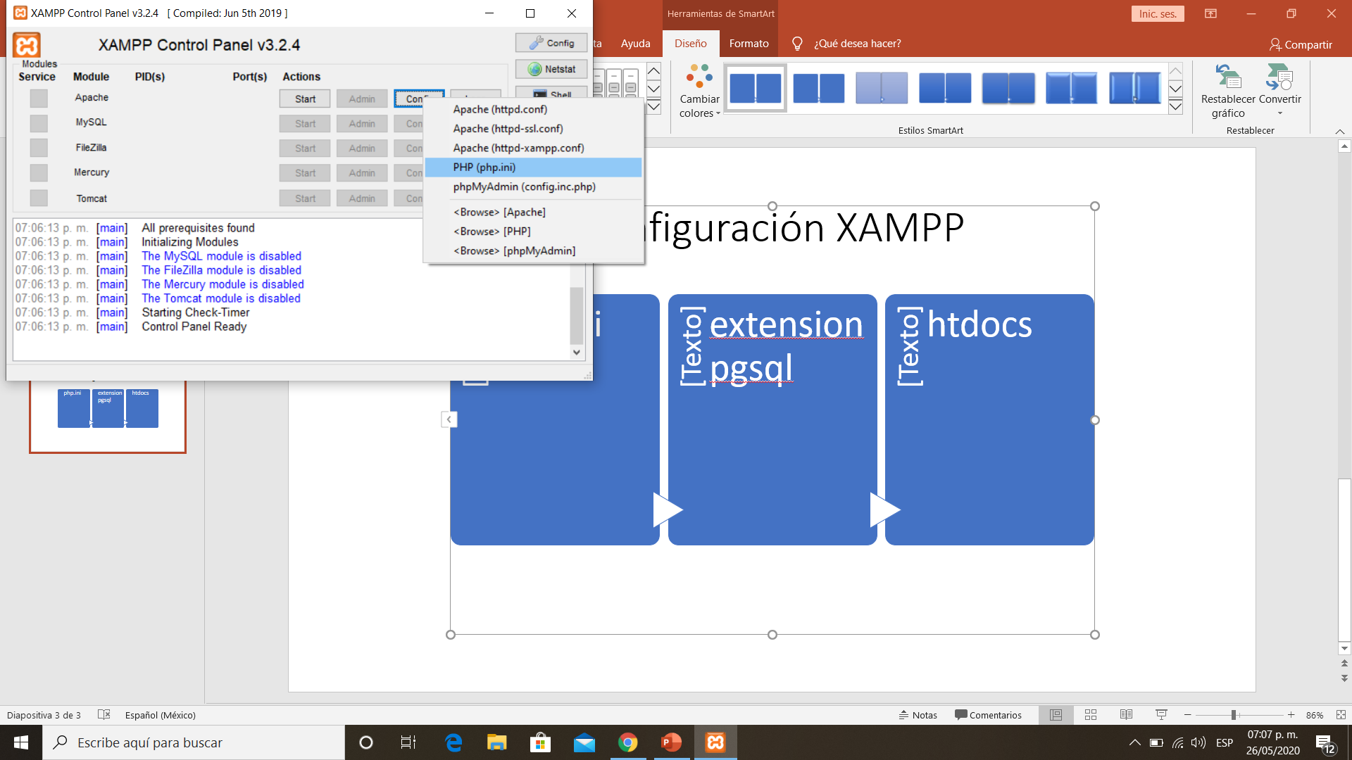
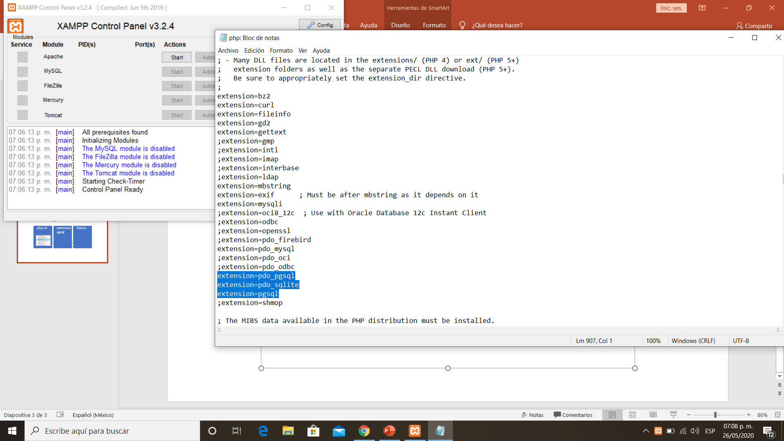
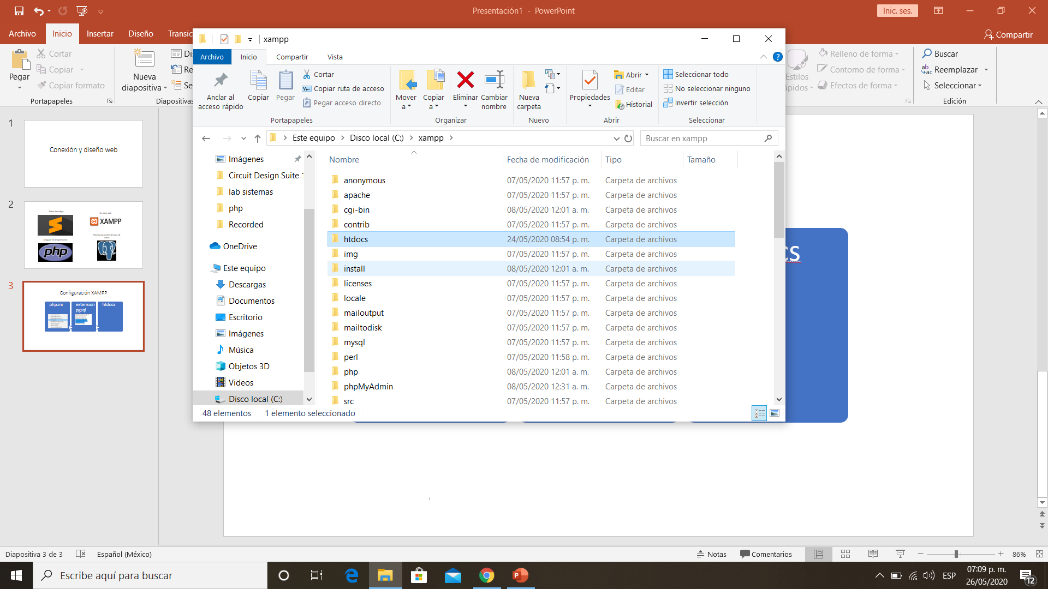
XAMPP Configuration
config
php.ini
edit
extension pgsql
ruta
htdocs

Slide 13
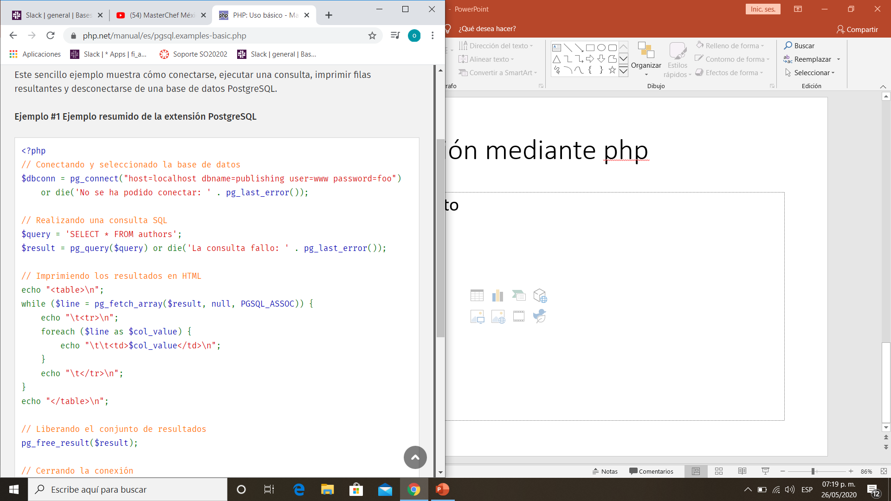
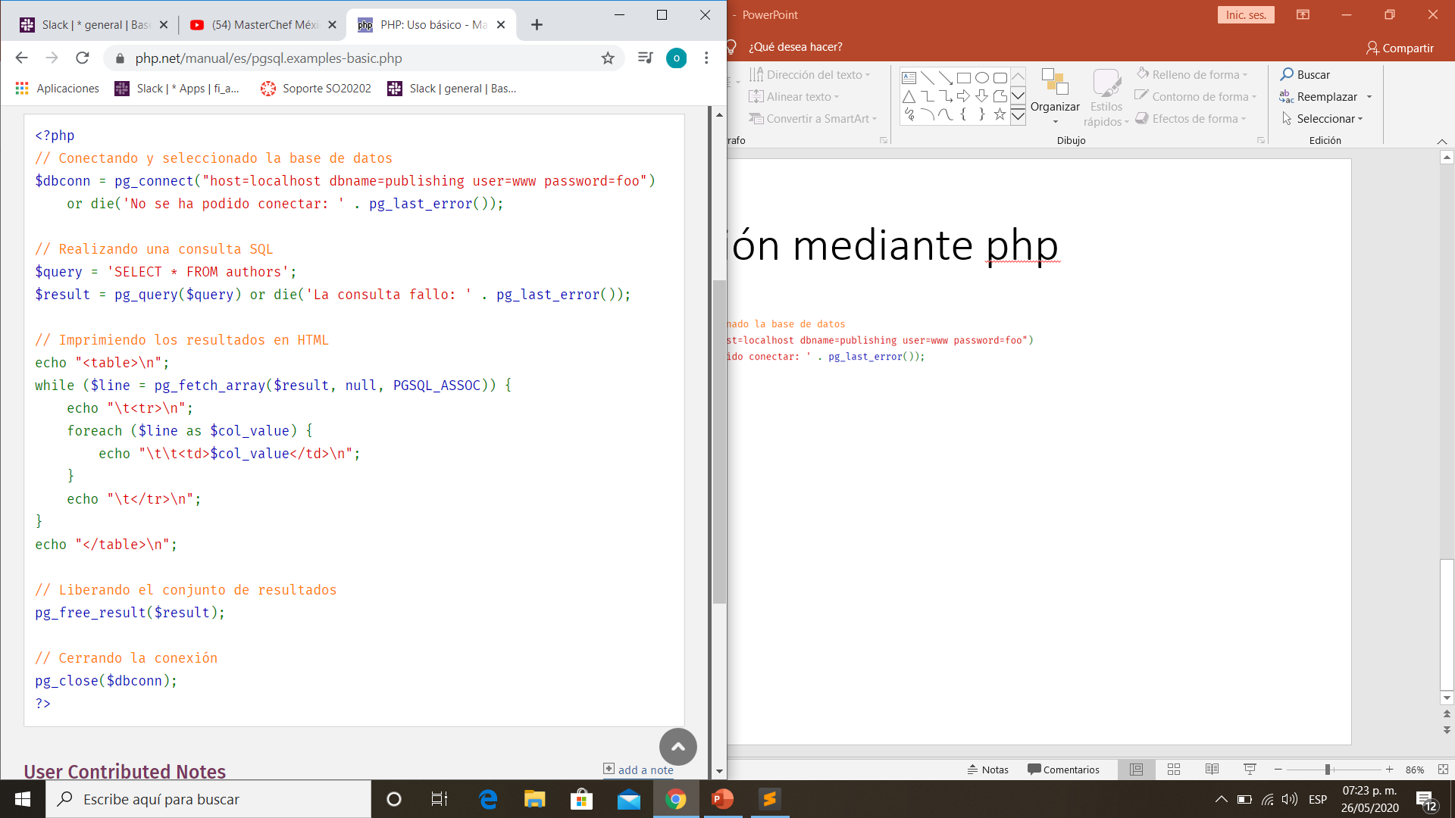
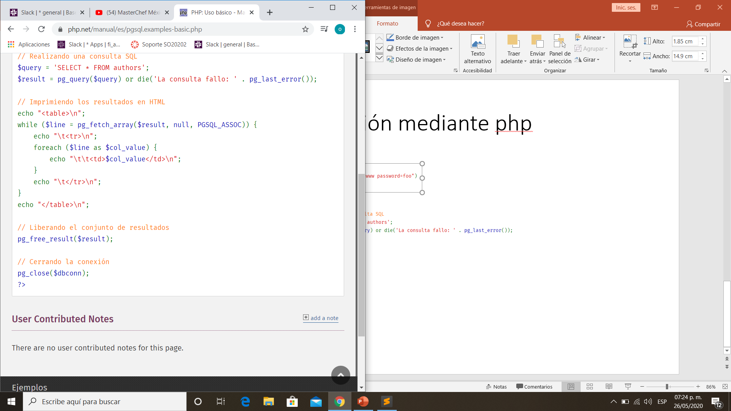
Implementation: Connection between the database and the web page

Slide 14
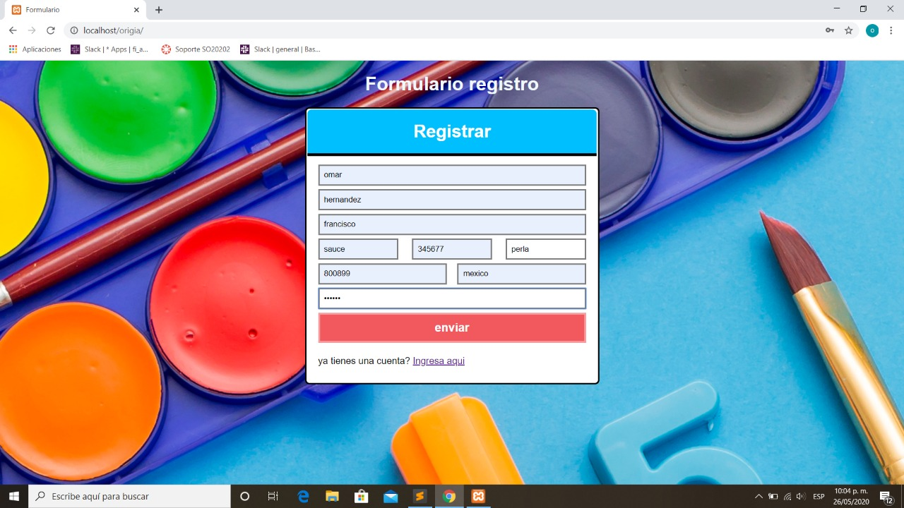
Result

Slide 15
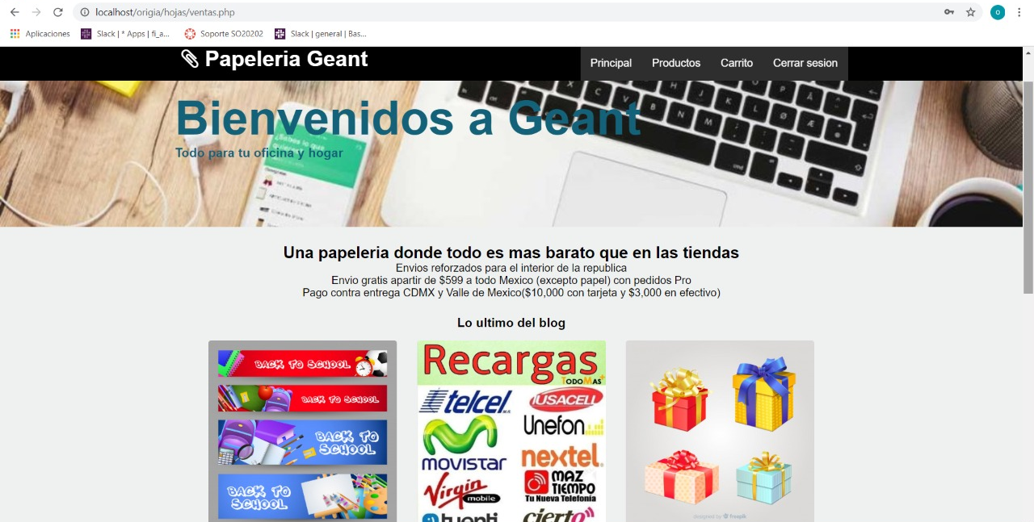
Result

